Slide 1
Brazilian Flora 2020 User Manual
2019

Slide 2
Contact: floradobrasil2020@jbrj.gov.br
How to cite: Filardi, F.L.R., Leitman, P.M. & Forzza, R.C. 2019. Brazilian Flora 2020 User Manual. Jardim Botânico do Rio de Janeiro, Rio de Janeiro, V1.0, 53p.

Slide 3
Index
General Information
Accessing the workspace
Configuration of controlled fields for a species file
3.1 Inclusion of a character
3.2 Selecting terms from the glossary Terms
3.3 Combining glossary terms and including numbers
3.4 Inclusion of character states
3.5 Default option for a character state
3.6 Ordering the terms of the automatic description
4. Record fill for genus and/or family
5. Record fill for a species within a genus
5.1 Controlled fields for species
5.2 Free text fields for species
6. Algae, Bryophytes and Fungi
7. See list of Glossary Terms
8. See list of Glossary Colours
9. Edition of the tab Nomenclature, Life Form and Distribution
9.1 Nomenclature
9.2 Voucher Inclusion
9.3 Associating images of specimens
9.4 Reference and Association of Images from Flora brasiliensis
9.5 Life Form and Substrate
9.6 Distribution
9.7 Vernacular Names, References and Internal Remarks
9.8 Inclusion of Field Images and Scientific Illustrations

Slide 4
Brazilian Flora 2020
1. General Information
The Brazilian Flora 2020 project adresses national and international targets signed by the Brazilian Government, centering around the consolidation of a national flora (including algae, fungi and land plants) in a platform that can be integrated into the model currently being developed for the World Flora Online (WFO).
The monographs generated by the Brazilian Flora 2020 are the responsibility of their authors and constitute original work, thus any content taken out from other sources should be clearly referenced.
The system was built to enable inclusion and consultation of the data taking into consideration the heterogeneous state of knowledge of the different taxonomic groups. The present system counts with two ways to include and present the data:
a) Controlled Fields - mandatory for vascular plants: consisting of options of multiple choice containing characters and character states chosen by the authors of each group from a glossary available within the system.
b) Free Text Fields: descriptions of the taxa will be included in a text box not-controlled with a large limit for character number.
The system as a whole was built in three languages: Portuguese, English and Spanish. Each author will be able to select the language for their monography.
The controlled fields will be shown in all three languages but the free text fields will be only present in the language chosen by each author to include his/her text (identification keys, descriptions, and comments).
We strongly recommend that the filling of the free text fields follow the same language used for the controlled fields, but we remind you that this information may also be included in any of the three languages.
Drawings and photos may be included to illustrate and to help in the recognition of taxa. The photos and illustrations included in the “Lista do Brasil” will be automatically imported, but may be withdrawn by author (s).

Slide 5
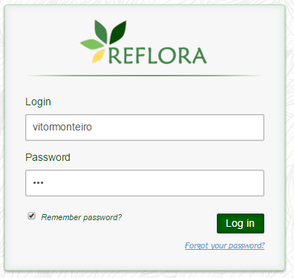
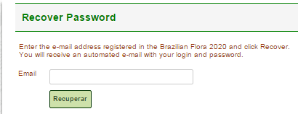
Brazilian Flora 2020
2. Accessing the workspace
Access http://reflora.jbrj.gov.br/
Click the “Login” button
Click “Forgot your password?”
Insert your e-mail and click the “Recover” button to receive an automatic message with your login and password
The e-mail registered in the system is the same one that received the message from the Brazilian Flora 2020

Slide 6
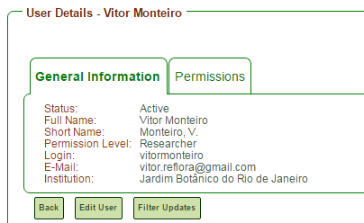
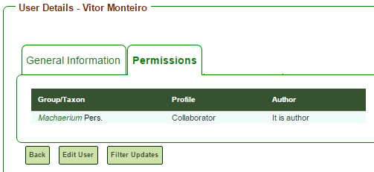
Brazilian Flora 2020
2. Accessing the workspace
After accessing the system you can click on your login (in the upper right corner of the page) to see the options “Settings” and “Change Password”
Click on “Settings” to see the tabs “General Informations” and “Permissions”
In the tab “General Informations” you can edit your personal data
In the tab “Permissions” you can see the taxa that you are allowed to edit.

Slide 7
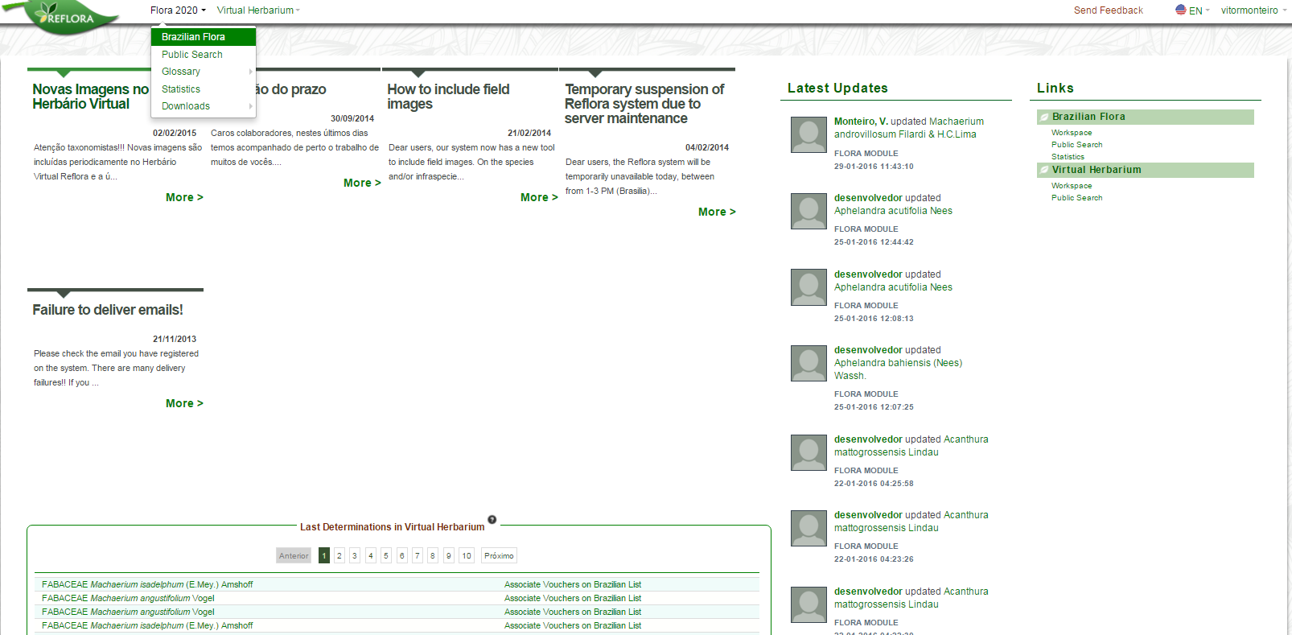
Brazilian Flora 2020
2. Accessing the workspace
In the Flora 2020 menu, click the option “Brazilian Flora” to access the workspace.

Slide 8
Brazilian Flora 2020
2. Accessing the workspace
All researchers will be able to view all branches of the taxonomic tree, but they will only have access to editing the taxonomic branches under their responsibility.
From the second login, the start page of the workspace displays the record of the last taxon worked on.
Button “Actions”
Error Report: indicates names with inconsistencies, such as synonyms without the indication of the accepted name.
Taxon statistics: available up to the hierarchical level of genus.
Taxon inclusion: inclusion of new genera from the family record data, inclusion of new species from the genus record data, inclusion of a new infraspecies from the species record data.
Buttons to:
Hide / show synonyms in the tree
Hide / show authors in the tree
Simple or multiple mode navigation in the tree
“Edit” Button

Slide 9
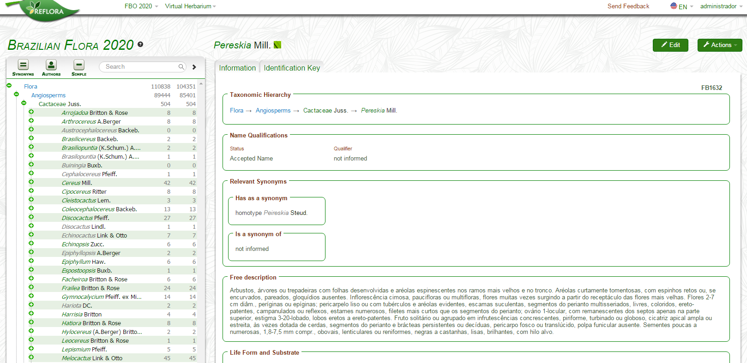
3. Configuration of controlled fields for a species within a genus
Select the genus to be configured in the taxonomic tree.

Slide 10
3. Configuration of controlled fields for a species within a genus
After selecting the genus to be worked on, click the "Edit" button.

Slide 11
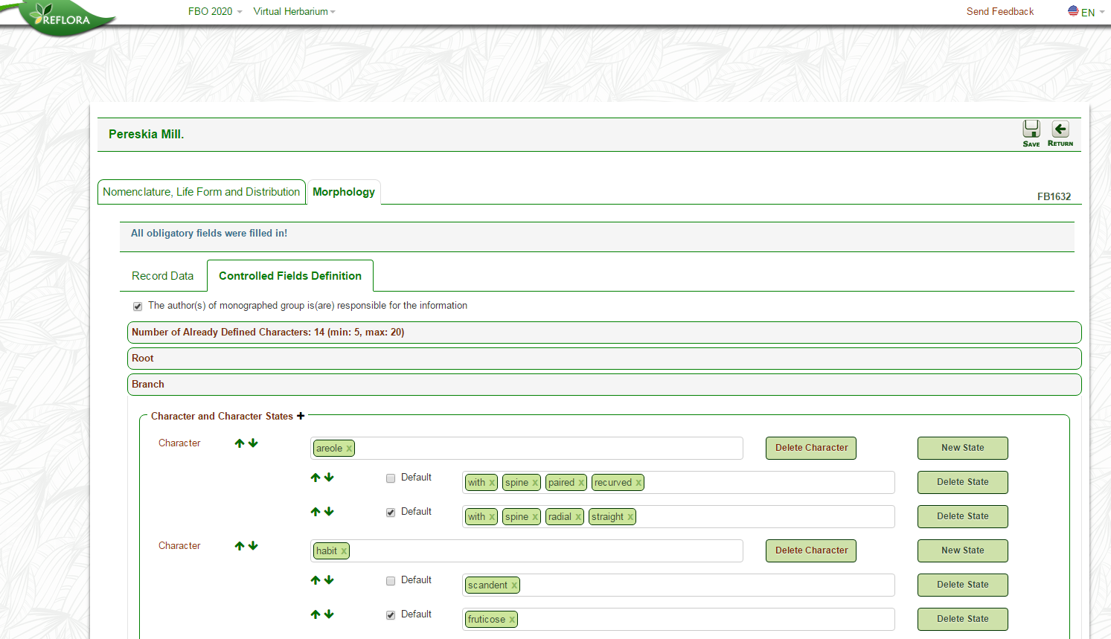
3. Configuration of controlled fields for a species within a genus
The configuration of the controlled fields is madatory for vascular plants – Angiosperms, Gymnosperms, Ferns and Lycophytes
Click on the "Controlled Fields Definition" to set the genus record.

Slide 12
3. Configuration of controlled fields for a species within a genus
Minimum and maximum number of characters for the genus configuration.
These values were determined by the project management committee and only the coordinators can modify them.

Slide 13
3.1 Inclusion of a character
Click on one of the "main boxes" (Root, Branch, Leaf, Inflorescence, Flower, Fruit, Seed)
After the expansion of the "main box", click on the button "+" to add a character.

Slide 14
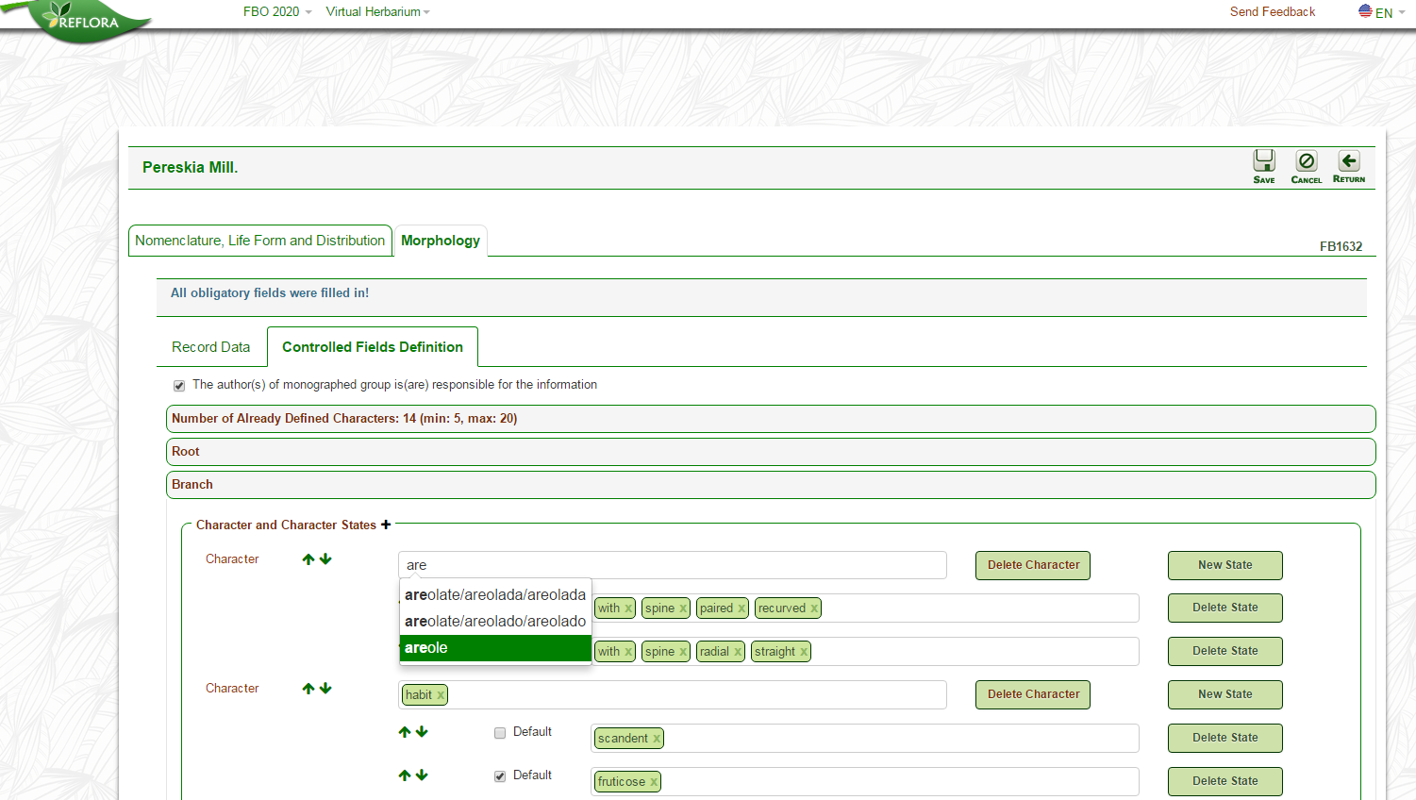
3.2 Selecting terms from the glossary
When you start typing, the system displays glossary terms.
To select a term you must press the ENTER key.

Slide 15
3.3 Combining glossary terms and including numbers
More than one term can be selected to make up either a character or a character state.
At every term selected the user must press the ENTER key.
Any number can be inserted, just by typing the numeral and pressing ENTER.

Slide 16
3.4 Inclusion of character states
Click on this button to add a character state .

Slide 17
3.4 Inclusion of character states
Each character must contain at least two character states!

Slide 18
3.5 Default option for character states
When you select the Default option, all species of the genus will have this character automatically selected.
The aim of this type of labelling is to facilitate the completion of the species record.
So if 90% of the species of a genus have the same character state, when selecting the Default option, the specialist will need to deselect this character state from 10% of the species, thus speeding their work.

Slide 19
3.6 Ordering the terms of the automatic description
This button changes the order in which the character will appear in the automatically generated description for the species.

Slide 20
3.6 Ordering the terms of the automatic description
These buttons change the order in which the character state will appear in the automatically generated description for the species.

Slide 21
3.6 Ordering the terms of the automatic description
Button to remove the character and all its character states.

Slide 22
3.6 Ordering the terms of the automatic description
Button to remove only the character state

Slide 23
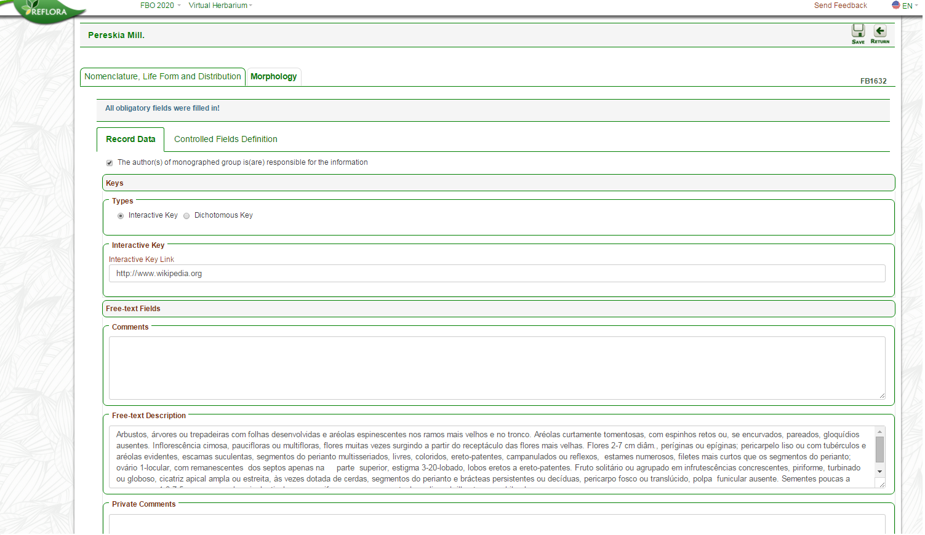
4. Record Fill for Genus and/or Family
Click on the “Record Data" to fill out the "Free text fields" of genus and family.
The descriptions for genus and family will be “Free-text Description“ only.

Slide 24
4. Record Fill for Genus and/or Family
The genera have the following free text fields:
Interactive Key – The user must insert a link to their interactive key if using that (either 1 or 2 is mandatory)
Dichotomous Key – Text box for the user to type or paste your key if using this.
Comments – Comments related to the genus that will appear on the public page.
Free-text Description – Text box for the user to type or paste the description.
Private Comments – Comments that appear only in the work area of the system and that may assist in communication between multi-authored monographs.

Slide 25
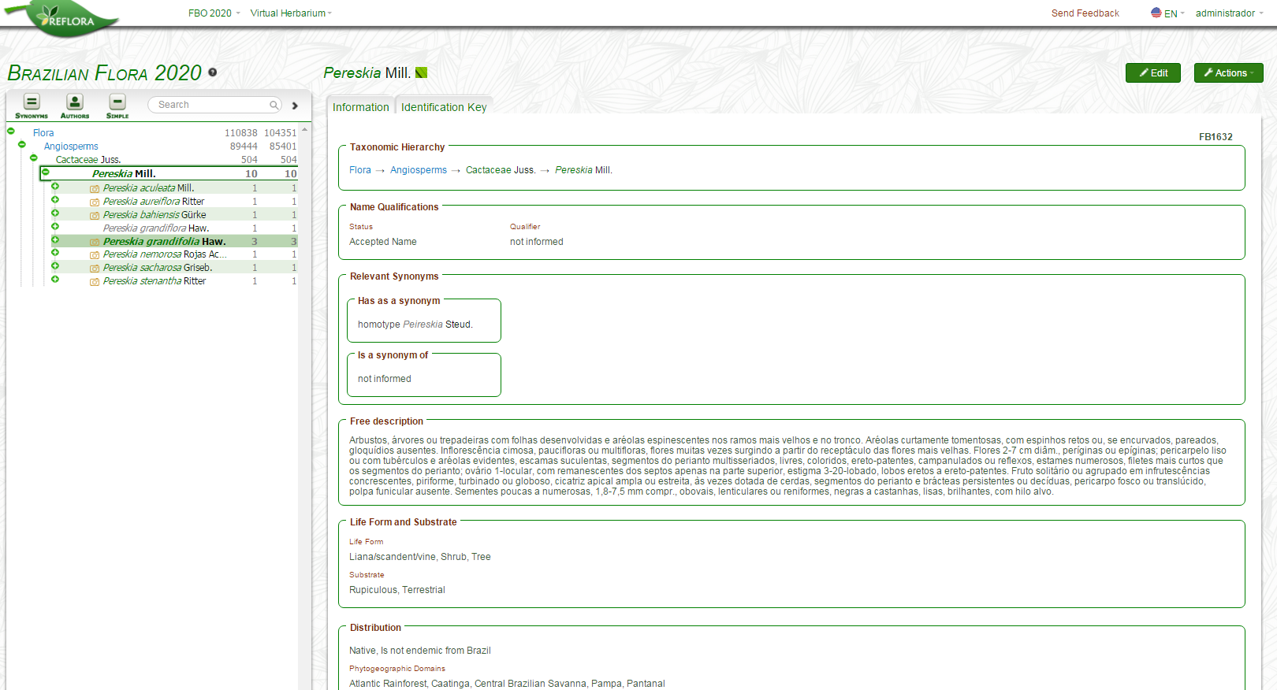
5. Record Fill for a Species within a Genus
Select the species to be filled in the taxonomic tree.

Slide 26
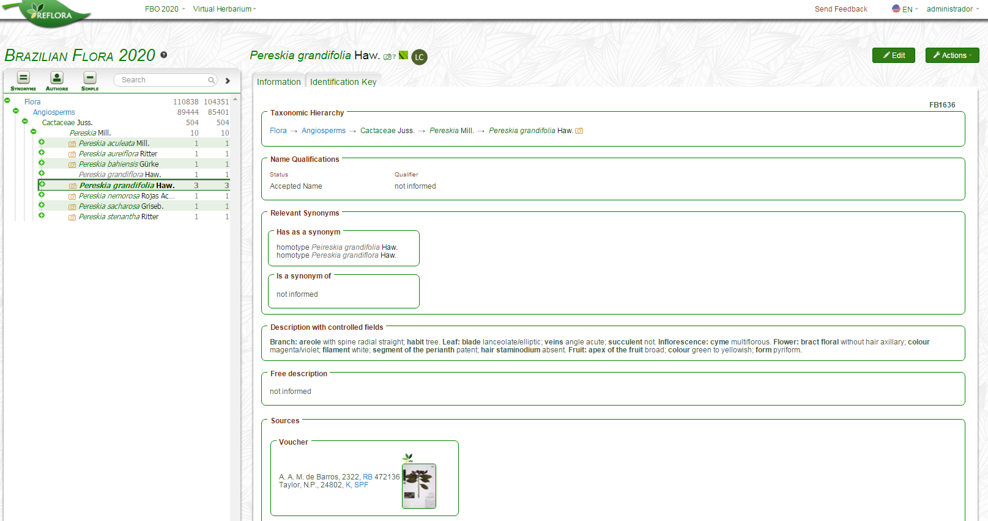
5. Record Fill for a Species within a Genus
Click on the "Edit" button to fill in the "Controlled Fields" and "Free text Fields" for the species.

Slide 27
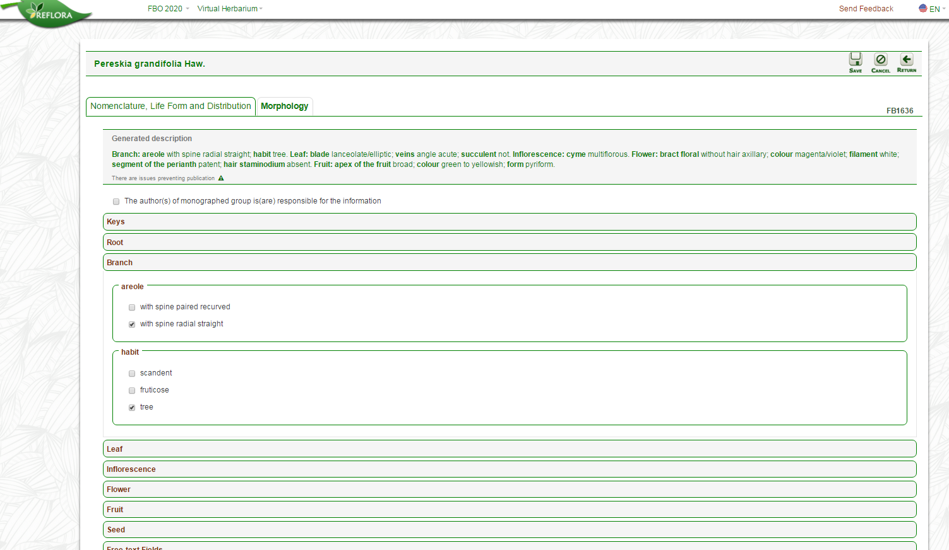
5.1 Controlled Fields for Species
Filling out the controlled fields is mandatory for species of vascular plants - Angiosperms, Gymnosperms, Ferns and Lycophytes.
Select the character states to describe the species.

Slide 28
5.1 Controlled Fields for Species
As the fields are filled the system will generate automatic description of the species.

Slide 29
5.1 Controlled Fields for Species
While there are characters still without a selected character state the system will not allow the data of the tab "Morphology" to be published in the public page.
If the selection of the controlled fields of one species is identical to the one of a previously filled species, the system informs you that "There are issues preventing publication“.
In this case the user will have to modify the completion for one of the conflicting species or will have to inform in the “Free text Description" a feature that distinguishes this species from the other.

Slide 30
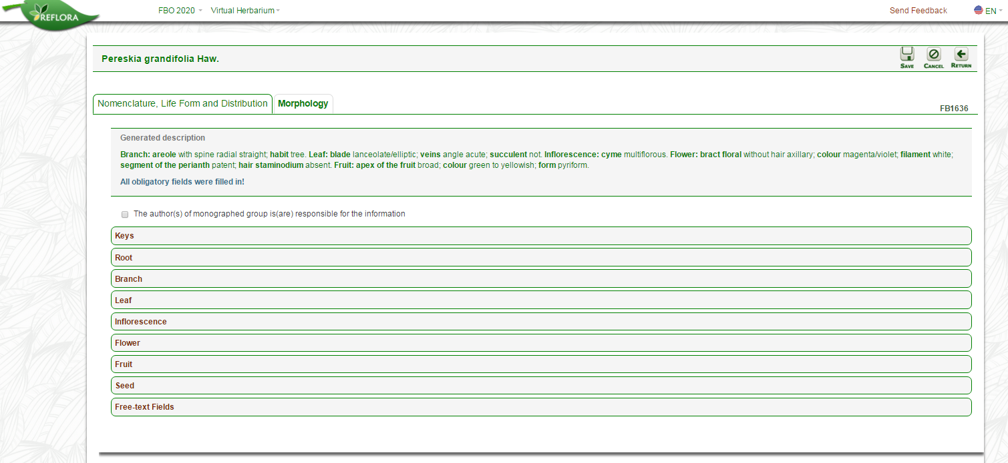
5.1 Controlled Fields for Species
After filling out all the required fields and solving possible problems the system releases the data of the tab "Morphology" to be published in the public page.

Slide 31
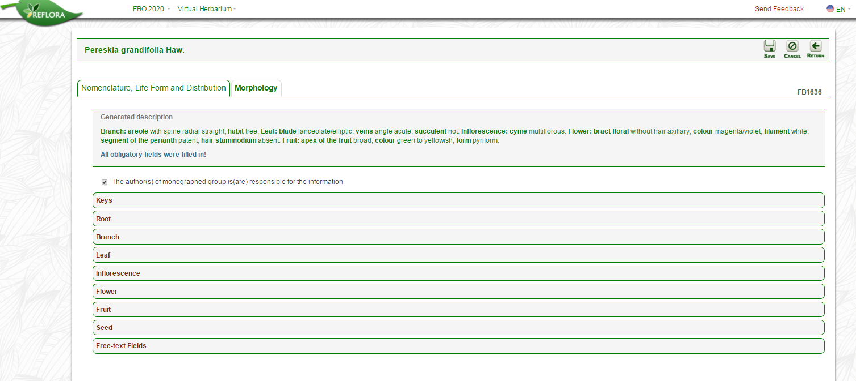
5.1 Controlled Fields for Species
After any change in the species record, the system requires the user to confirm responsibility for the information.

Slide 32
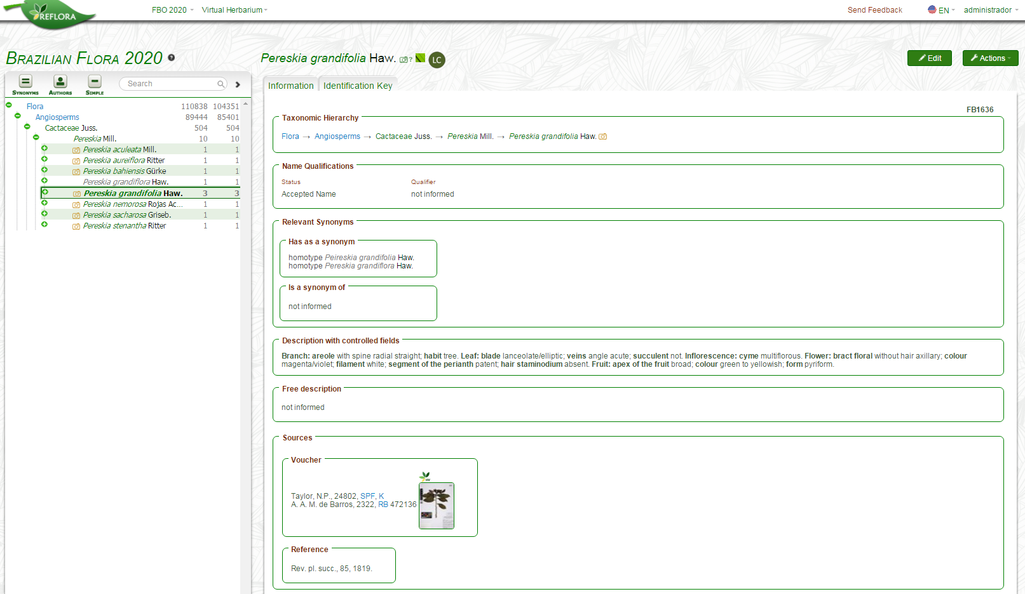
5.1 Controlled Fields for Species
After the "Controlled Fields" are complete, the system generates an automatic description of the species, which appears in the same place that displays information about nomenclature, life form, and distribution.

Slide 33
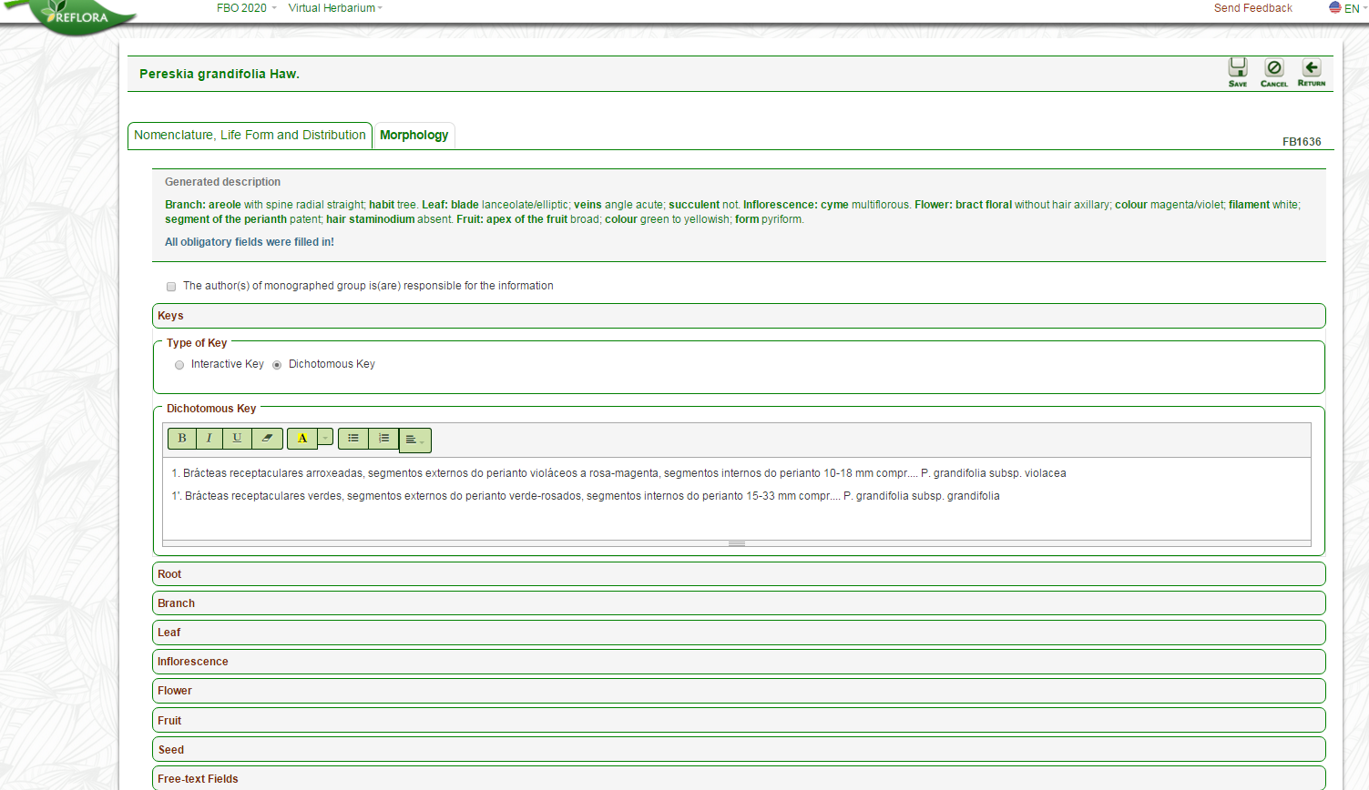
5.2 Free Text Fields for Species
The species have the following free text fields:
Interactive Key – The user can insert a link to their interactive key if there are infraspecific taxa
Dichotomous Key – Text box for the user to type or paste key if there are infraspecific taxa
Comments – Comments related to the species that will appear on the public page.
Free-text Description – Text box for the user to type or paste a description or to differentiate between similar species
Private Comments – Comments that appear only in the system work area and which may assist in communication between those responsible for multi-authored monographs.
Click on "Free text Fields" to see the other options (Comments and Description).

Slide 34
5.2 Free Text Fields for Species
Key field
This field is only available for species with infraspecific taxa
The user may choose to complete the Interactive Key OR Dichotomous Key.

Slide 35
5.2 Free Text Fields for Species
Text formatting tool for Dichotomous Key.

Slide 36
5.2 Free Text Fields for Species
Option for Interactive Key.
The user must inform the link where the interactive key is found.

Slide 37
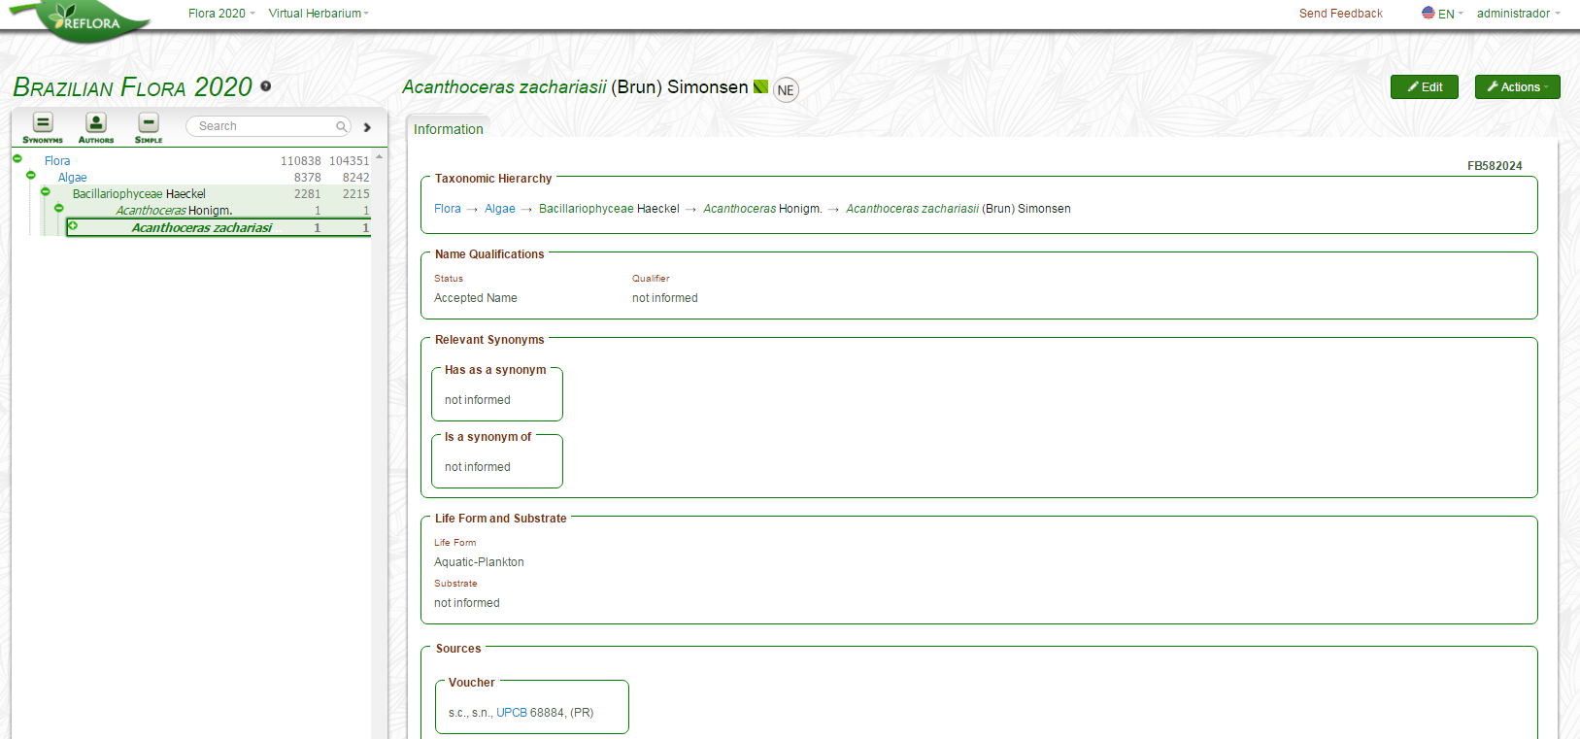
6. Algae, Bryophytes and Fungi
Algae, Bryophytes and Fungi do not have "Controlled Fields", therefore for them the "Free Text Description" IS MANDATORY.

Slide 38
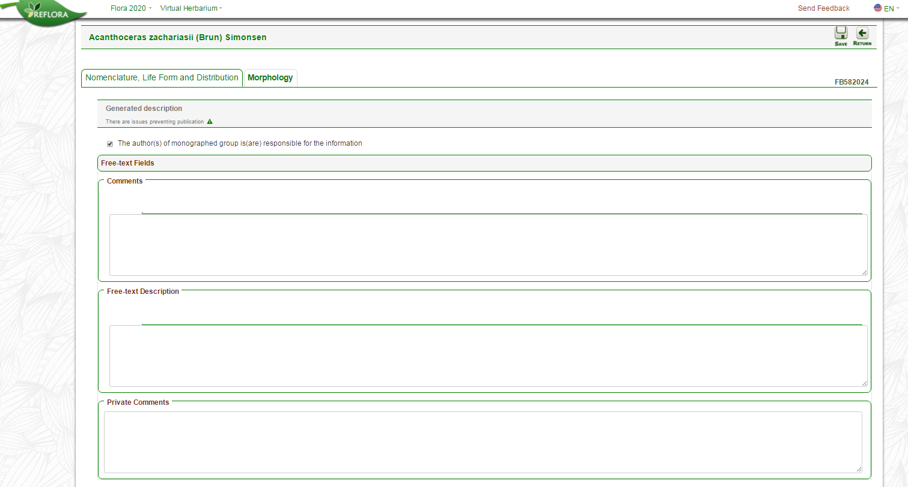
6. Algae, Bryophytes and Fungi
Algae, Bryophytes and Fungi have the following free text fields:
Interactive Key – The user must insert a link to their interactive key if using this (either 1 or 2 is mandatory).
Dichotomous Key – Text box for the user to type or paste key if using that
Comments – Comments related to taxa that will appear on the public page.
Free-text Description – Text box for the user to type or paste your description.
Private Comments – Comments that appear only in the working area of the system and which may assist in communication between those responsible for monographs.

Slide 39
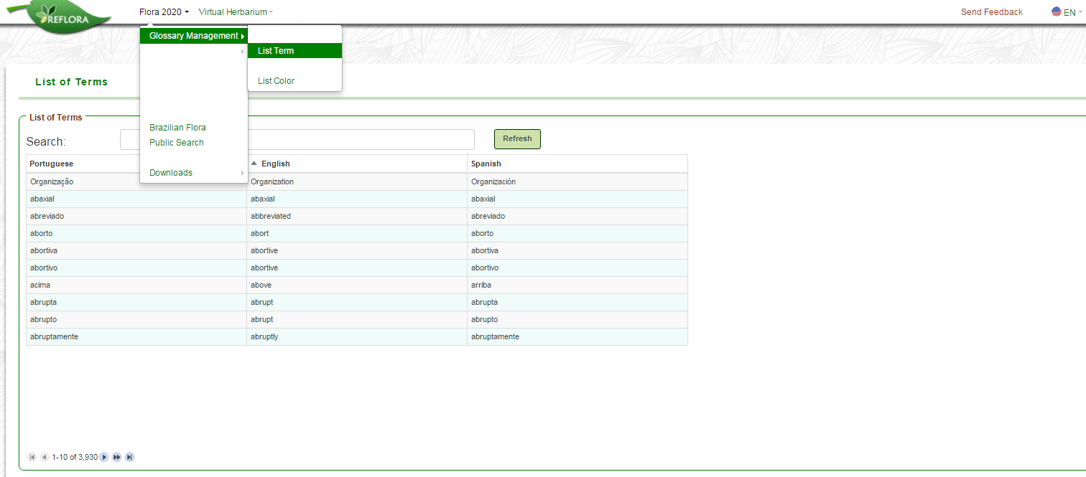
7. See List of Glossary Terms
All users can view the list of terms.
Field to search terms
The glossary of terms was based on different sources attempting to cover the greatest possible diversity of botanical terms for the different groups. Other nouns, adjectives, adverbs and prepositions pertinent to short descriptions of plants found in the botanical literature were also included.
If it is necessary, the registration of new terms may be made by system administration.

Slide 40
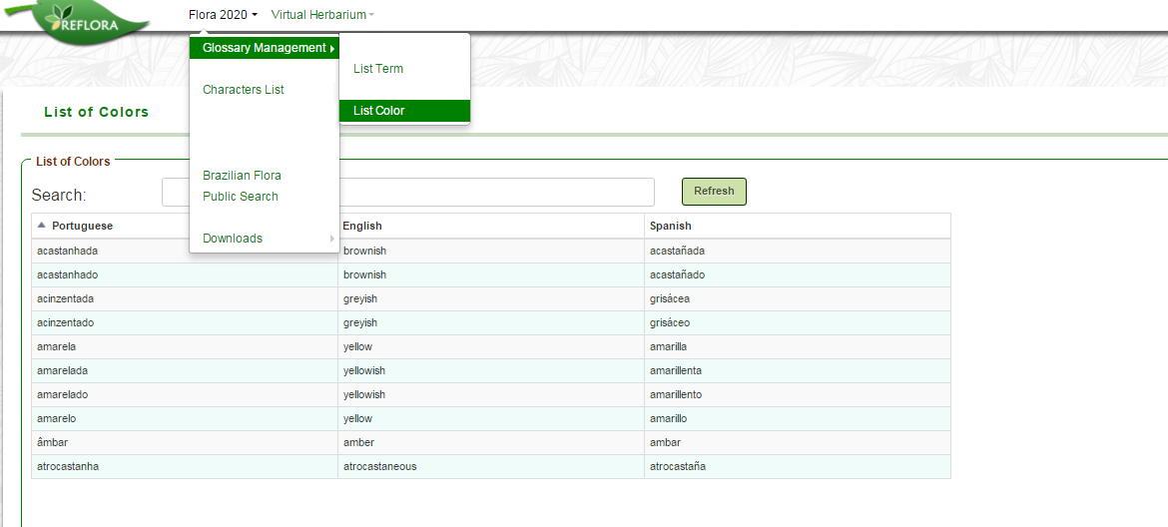
8. See List of Glossary Colors
All users can view the list of colours.
Colours were simplified to avoid ambiguity or nearly synonymous terms (pink/pinkish/rose).

Slide 41
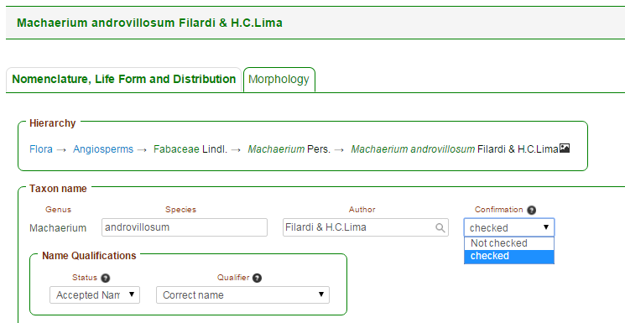
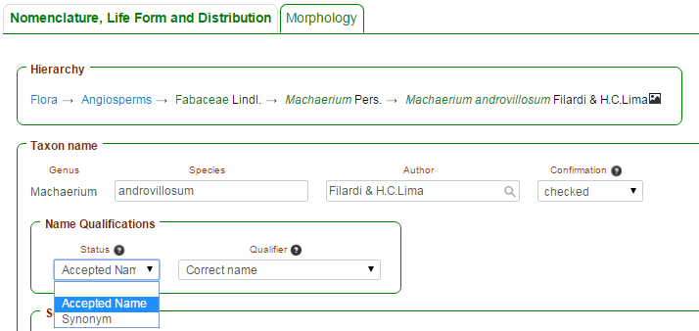
Brazilian Flora 2020
9. Edition of the Tab “Nomenclature, Life Form and Distribution”
9.1. Nomenclature
A record "Checked" will be available for publication.
A record “Not checked" will not be available for publication and the taxon name will appear in red in the taxonomic tree and in the taxon record data.
An extensive survey on all floras published for Brazil (Flora brasiliensis, Flora Catarinense, etc.) was carried out, and for this reason, the taxonomic tree has many names marked as “Not checked" and these must be prioritized by the specialists.
Name Qualifications:
Status “Empty” - names with nomenclatural problems that appear in purple in the taxonomic tree and in the record data. In this case, the "Qualifier" field must be filled.
Status “Accepted Name” – will appear in green in the taxonomic tree and in the record data.
Status “Synonym” – will appear in grey in the taxonomic tree and in the record data. In this case it will be necessary indicate the accepted name in synonymy relationship (see “Relevant Synonyms”)
The options in the “Qualifier” field are specific for each “Status” options.

Slide 42
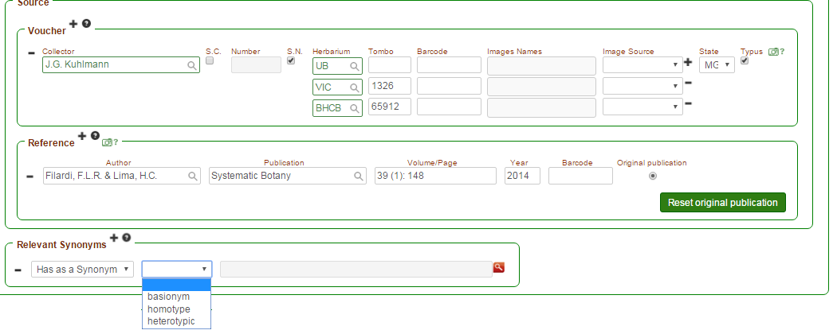
Brazilian Flora 2020
9. Edition of the Tab “Nomenclature, Life Form and Distribution”
9.1. Nomenclature
Name with Status = Synonyms
It will be necessary indicate the accepted name in the field “Relevant Synonyms”
Name with Status = Accepted Name
It is possible to indicate synonyms in the field “Relevant Synonyms”
Name with Status = Empty
It is not possible to indicate a accepted name or a synonym in the field “Relevant Synonyms”
Click the button “+” to include a name and “-” to exclude a name
It is possible to indicate the type of synonym: basionym, homotype, and heterotype
Click on the magnifying glass icon to search for the desired name

Slide 43
Brazilian Flora 2020
9. Edition of the Tab “Nomenclature, Life Form and Distribution”
9.2. Voucher Inclusion
Click the button “+” to include a voucher and on “-” to exclude a voucher
Click the button “+” to add duplicates for a voucher and “-” to exclude duplicates
The field “Herbarium” uses the Index Herbariorum as dictionary. Only the system administrator can add other acronyms
Field to select the State where the material was collected
Field to indicate if the material is a nomenclatural type

Slide 44
Brazilian Flora 2020
9. Edition of the Tab “Nomenclature, Life Form and Distribution”
9.3. Associating images of specimens
Clicking the "camera“ icon the user will see exsiccatae images available for association in the field "Voucher"
The system will display images of both accepted name and synonyms, as indicated by the expert, for the species or infraspecies.
The user can search images by the collector's name, collection number and barcode
After selecting the specimens the user must click on "Add selected“
All information relating to specimens will be automatically included in the field “Voucher"

Slide 45
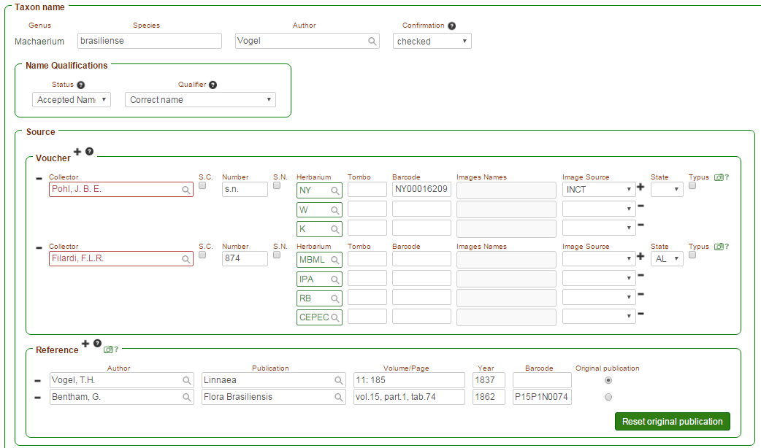
Brazilian Flora 2020
9. Edition of the Tab “Nomenclature, Life Form and Distribution”
9.4. Reference and Association of Images from Flora brasiliensis
The “camera” icon works on the same way in the fields “Voucher” and “Reference”
HOWEVER, the field "Reference" should only include illustrations and text images from the Flora brasiliensis (see the explanations above and the example below)
It is expected that the user include in this field the original work in which the given name was published.

Slide 46
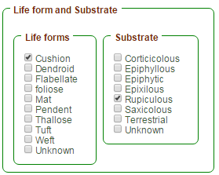
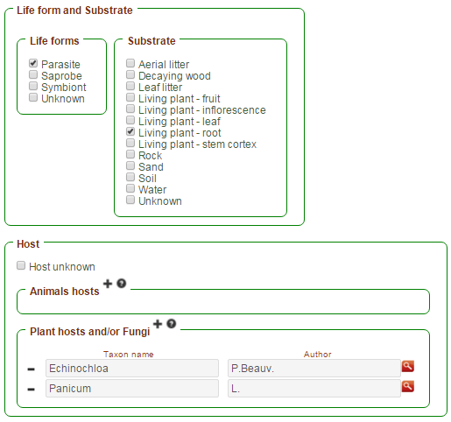
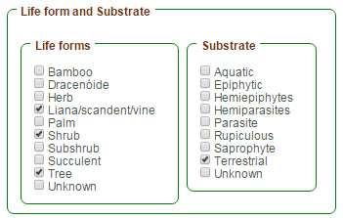
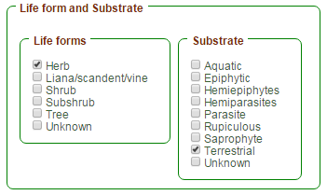
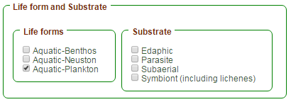
Brazilian Flora 2020
9. Edition of the Tab “Nomenclature, Life Form and Distribution”
9.5. Life Form and Substrate
The options for the fields “Life Form” and “Substrate” are specific for each major group
Bryophytes
Fungi
Angiosperms and Gymnosperms
Ferns and Lycophytes
Algae

Slide 47
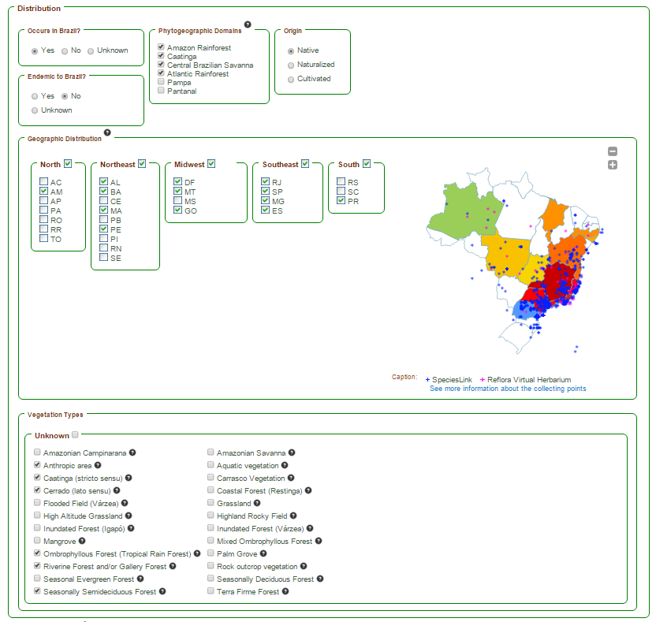
Brazilian Flora 2020
9. Edition of the Tab “Nomenclature, Life Form and Distribution”
9.6. Distribution
The “Distribution" field is divided into six other fields: “Occurs in Brazil?" "Endemic to Brazil?" "Phytogeographic Domains ", "Origin", "Geographical Distribution" and "Vegetation Types“
Information about distribution are included by specialists only for species and infraspecies
Information on distribution shown for the genera and families represents the sum of what was included by specialists for the species and infraspecies
All other distribution fields are hidden if the user chooses the options "No" or “Unknown" for the field "Occurs in Brazil?“
All distribution fields are hidden for names with synonyms or empty status

Slide 48
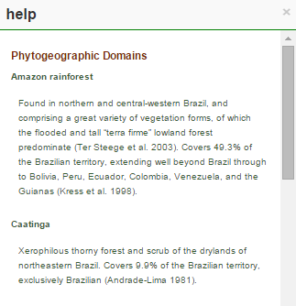
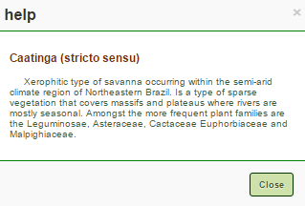
Brazilian Flora 2020
9. Edition of the Tab “Nomenclature, Life Form and Distribution”
9.6. Distribution
By clicking on the icons "?" of the fields "Phytogeographic Domains " and "Vegetation Types" the user views the descriptions elaborated by members of the management committee for the six Domains and the 24 vegetation types adopted.

Slide 49
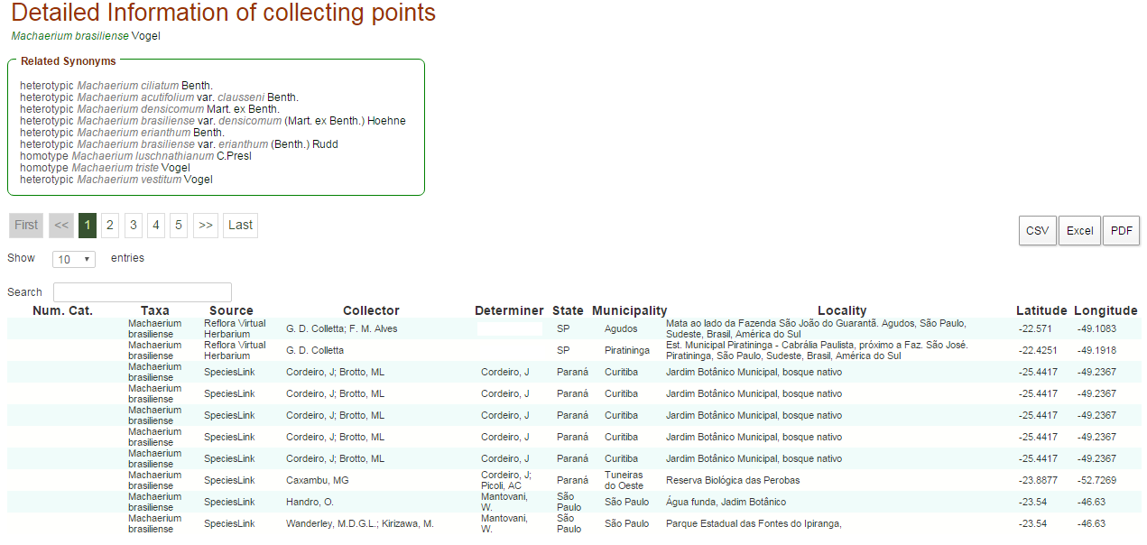
Brazilian Flora 2020
9. Edition of the Tab “Nomenclature, Life Form and Distribution”
9.6. Distribution
Geographic Distribution
If the user marks the checkbox beside a Region, all the states of this Region will appear in colour on the map
To mark specific states of a region, the user must click the check box next to the acronym of the State.
Clicking one time in the check box, the map will be filled with specific colours: green for North Region, yellow for Midwest, orange for Northeast, red for Southeast, and blue for the South Region.
Clicking 2 times on the checkbox it will be marked with the "?" indicating uncertainty in occurrence. In this case, State (s) or Region (s) will be colored gray on the map.
By hovering over the occurrence points marked on the map (coming from the Reflora Virtual Herbarium and INCT records), the user will see the taxon name, abbreviation of the herbarium, and coordinates.
By clicking “See more information about the collecting points" the user will have access to a table with all the information related to these records. This table can be exported to Excel, CSV and PDF.

Slide 50
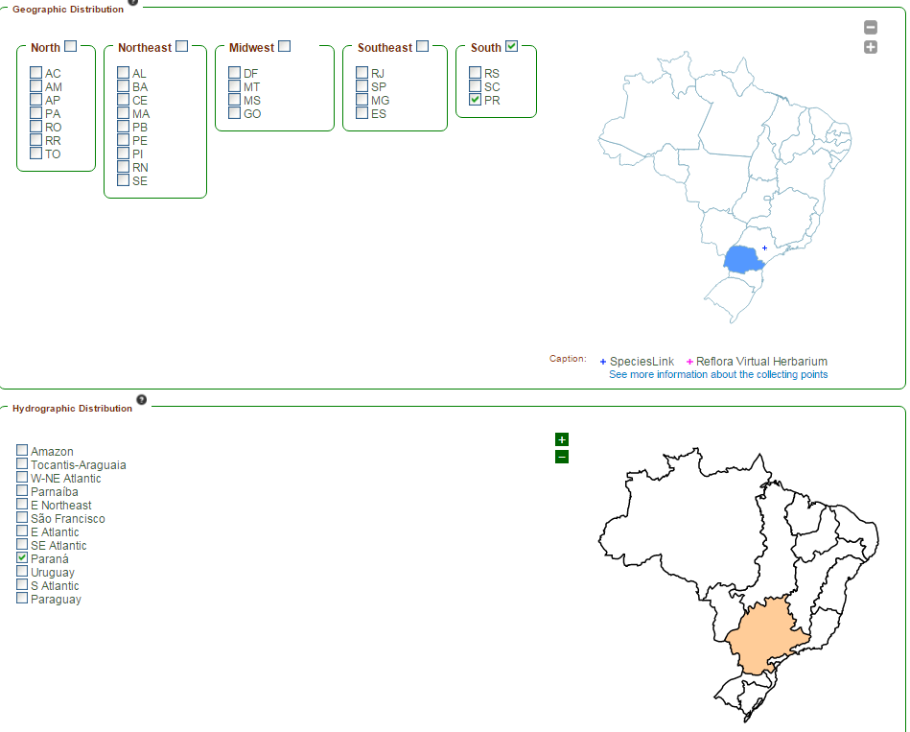
Brazilian Flora 2020
9. Edition of the Tab “Nomenclature, Life Form and Distribution”
9.6. Distribution
Geographic Distribution
Algae
It is possible indicate the distribution by Regions and States - "Geographical Distribution" - as well as by Hydrographic Regions - "Hydrographic Distribution“
The coloring of the maps follows the same principle presented to the other groups.
By hovering over the occurrence points marked on the map (coming from the Reflora Virtual Herbarium and INCT records), the user will see the taxon name, abbreviation of the herbarium, and coordinates.
By clicking “See more information about the collecting points" the user will have access to a table with all the information related to these records. This table can be exported to Excel, CSV and PDF.

Slide 51
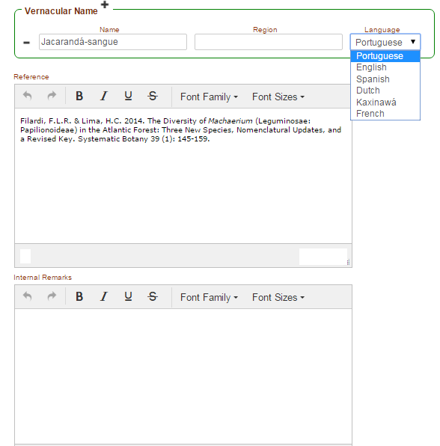
Brazilian Flora 2020
9. Edition of the Tab “Nomenclature, Life Form and Distribution”
9.7. Vernacular Name, References and Internal Remarks
Vernacular Name
Click on the button “+” to include a name and “-” to exclude a name
Select a language in the box for the vernacular or common name included.
In the field “Reference” all literature consulted for the preparation of monographs should be included.
We remind you that the authors must confirm they are responsible for all information included in the monographs and that their participation in the project may be cancelled if problems of ethic and/or plagiarism are detected.
The field "Internal Remarks" will not be displayed on the public page.
This field lists the primary sources used for inclusion of names in the system, since the first version of the "Lista do Brasil", for which work platform was launched for specialists in 2009.
For the present system, an extensive survey on all floras published for Brazil (Flora brasiliensis, Flora Catarinense, etc.) was carried out and resulted in the inclusion of new names, which are also referenced in this field.

Slide 52
Brazilian Flora 2020
9. Edition of the Tab “Nomenclature, Life Form and Distribution”
9.8. Inclusion of Field Images and Scientific Illustrations
Click the “Actions” button and select the option “Organize Images”
Click on “Send Image”
This field should include the name of the author of photo or illustration if the image author is not same person that is inserting the image
Up to 7 photos can be uploaded per species or infraspecies and the files must be in JPEG format and should have a maximum of 5MB
Do not forget to read the "Term of Responsibility" and mark your agreement.

Slide 53
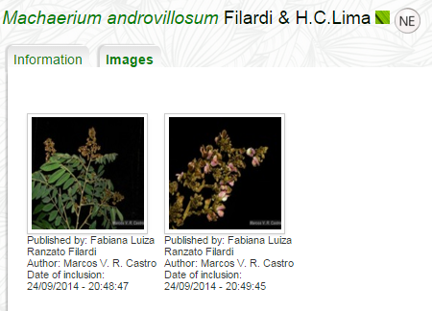
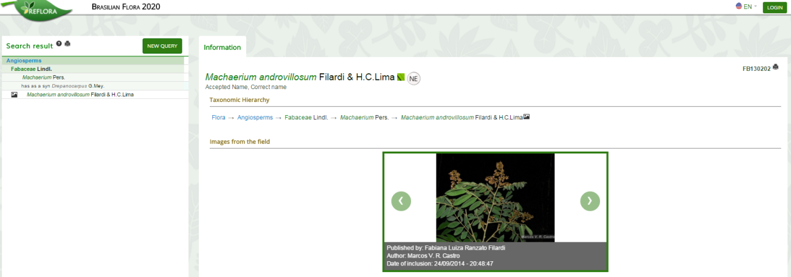
Brazilian Flora 2020
9. Edition of the Tab “Nomenclature, Life Form and Distribution”
9.8. Inclusion of Field Images and Scientific Illustrations
The photos and illustrations will be in the tab “Images” in the workspace...
...and will also appear straight away in the public page of the system!

Slide 54
Welcome to
Brazilian Flora 2020

